Slide 1
Peru – collection permits

Slide 3
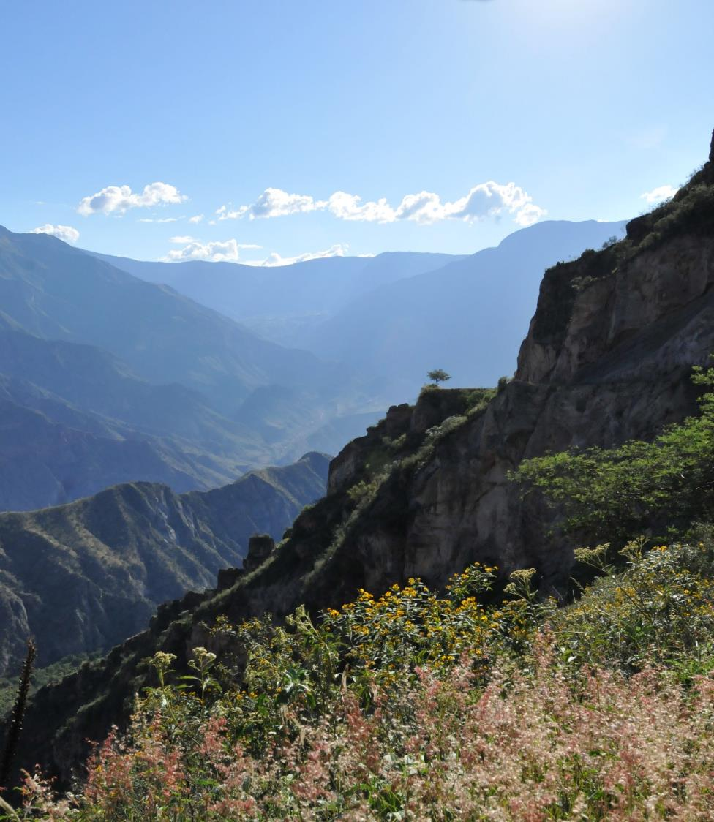
19,232 species

Slide 4
PERMITS
Ministerio de Agricultura y Riego (MINAG), Gestión Forestal y de Fauna Silvestre [old INRENA] http://dgffs.minag.gob.pe/index.php/procedimiento-administrativo
Need: National counterpart, short(ish) proposal
National herbaria:
LIMA: Universidad de San Marcos (USM), Universidad Agraria La Molina (MOL)
TRUJILLO: Universidad de Trujillo (HUT), Segundo Leiva (HAO)
CAJAMARCA: Isidoro Sanchez Vega (CPUN)
OXAPAMPA: Rudolfo Vasquez, team Missouri (HOXA)
CUSCO: ??? (CUZ)
AREQUIPA: Quipuscoa (HUSA), ??? (AQP)

Slide 5
PERMITS
Application process overview:
Collection permit (research proposal, cartas de presentacion para cada participante, CV)
102 nuevos soles
Processing time c. 2 weeks
Up to 3 years (even 5!!!)
Parques nacionales excluded, require a separate permits
Specific or of all taxa/geographic areas
You can add/change participants – Brazil strategy???
Export permit (list of exported specimens, list of deposited specimens in Peru, constancia de deposito), ≥50% dups need to remain in Peru!!!
102 nuevos soles
Takes c. 1 week to prepare, and 2 weeks to come through
Checking of permits required at airport at point of exit (post or personal carrying)
Genetic resources permit (research proposal, cartas de presentacion para cada participante, CV)
No cost
Slow processing of permit applications
Up to 5 years
Required from academic and non-academic projects
Process changing every year but stabilising and becoming more rapid (hopefully)

